Slide 1

Governance and Compliance with Microsoft Purview A getting started guide – Unified catalog
If you think compliance is complicated, feel free to try incompliance!
Jan Cordtz, Snr. Cloud Solution Architect
Microsoft Denmark
Note – in this document the name Purview – if not otherwise
stated - is used for the Data Governance part of Purview.

Slide 2
Get Purview Data Governance running

Slide 3
The Purview “Process”
Installation
Establish Domains
Data Map
Unified Catalog
Establish Governance Domains
Establish Collections
Establish Data Products
Register Sources
Connect assets to Data Products -> Governed assets
Establish assets
Scan
API
Enhance assets
Descriptions (scan?)
Owners
Lineage (scan?)
Glossaries
Classification (scan?)
Sensitivity
Enhance data product
Owners
Glossaries
OKR
Critial Data elements
Data Access
Advanced
Api’s
Workflows
Enforcement of rights

Slide 4
Establish the Unified Catalog
Unified Catalog

Slide 5
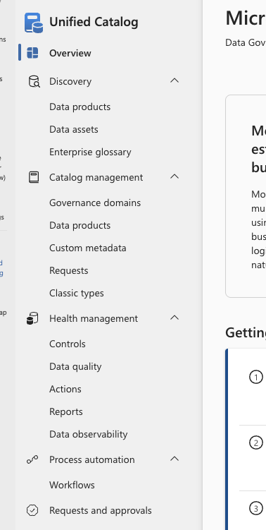
The Unified Catalog Purview menu
Discovery contains the search options for Purview. Note that data assets from the Data Map is in this menu part
Under Catalog management you will find what is the
Unified catalog and its content.
Health management has the reporting and quality items for
the Unified catalog and its content.
Process automation has one item being workflow where you can assign approval workflows etc.
Request and approvals is where you will find any request needed to be handled along with the request already processed.

Slide 6
Discovery
Search capabilities

Slide 7
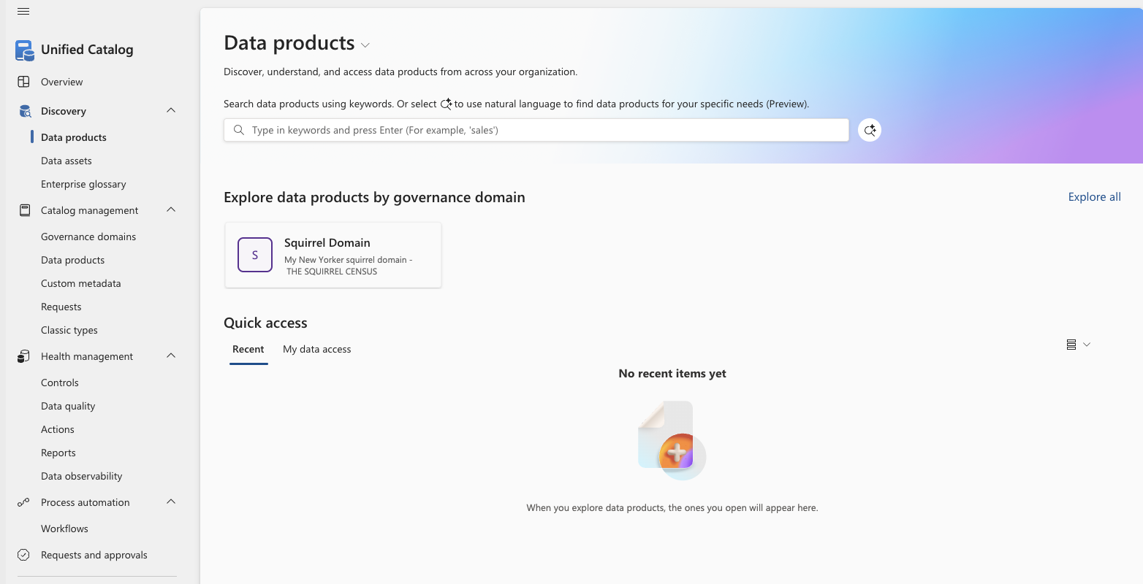
Search – data products
Here you can search your data products.
This can either be done using words,
clicking a published governance domain or
using natural language.
To use natural language, you need to click here.
Clicking a governance domain brings you to the data products in the domain.

Slide 8
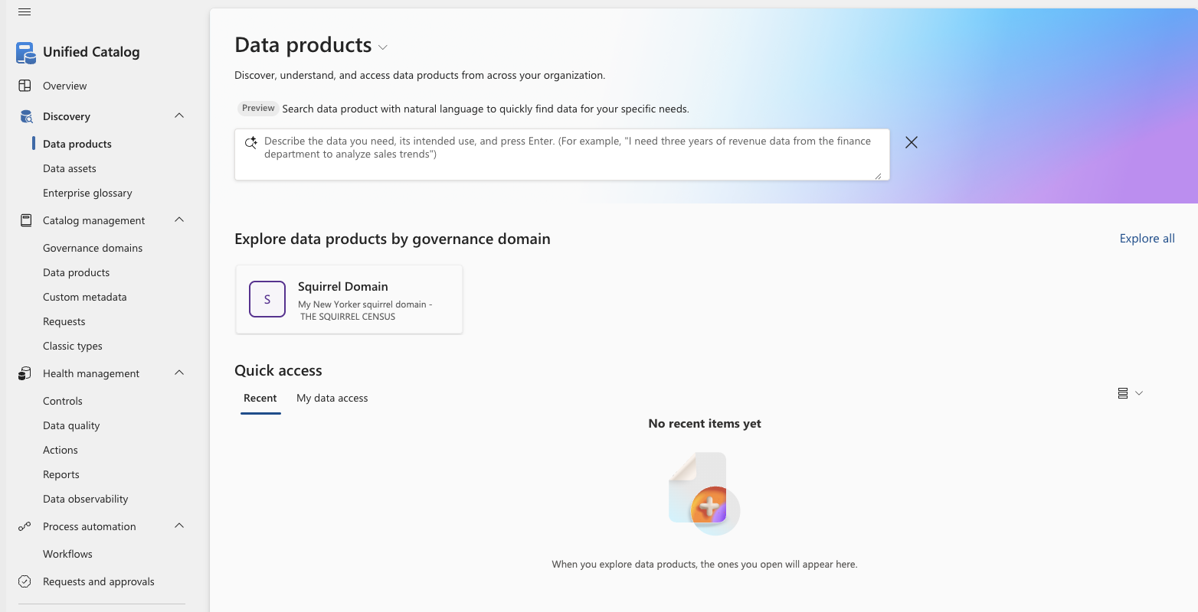
Search – data products – natural language
When using natural language for your search, you formulate in your words what it is your looking for.
So, instead how having an idea about what a data product might be called you instead write what it is you are really looking for.
Example (as shown): I need three years of revenue data from the finance department to analyze sales trends.

Slide 9
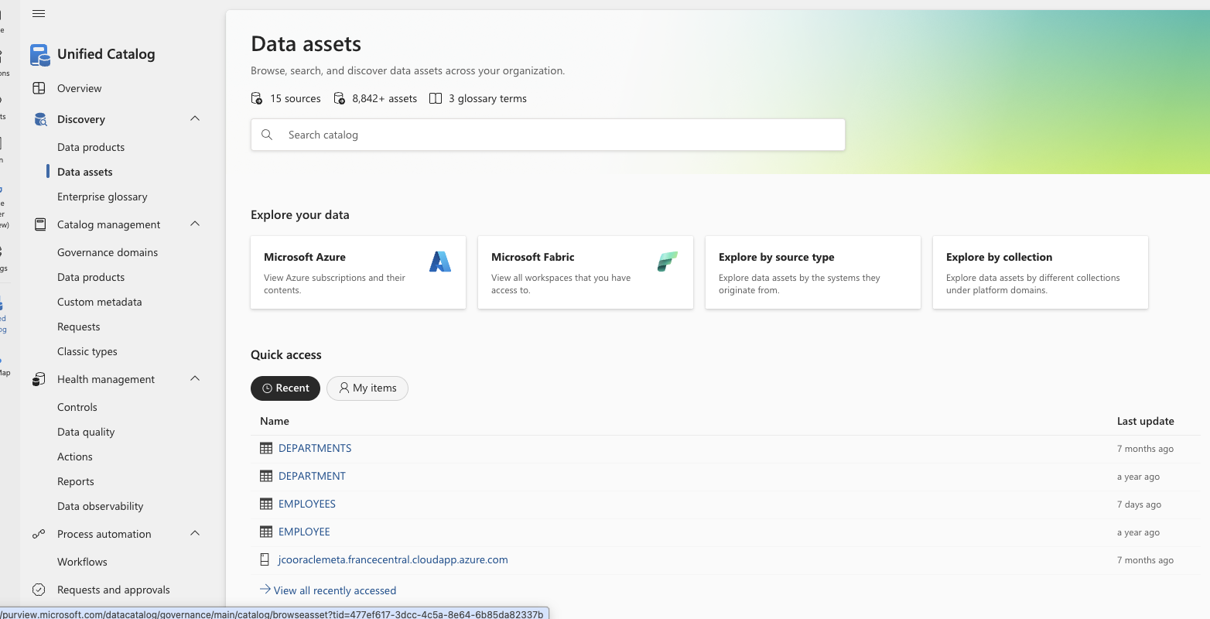
Search – data assets from the data map
The search for data assets is also located in the discovery menu under Unified catalog.
Here you search using words.
You can also click the explore options where you can find assets related to one the following option
Azure
Fabric
Source type
Collection
Purview also show recent found data assets under Quick access.

Slide 10
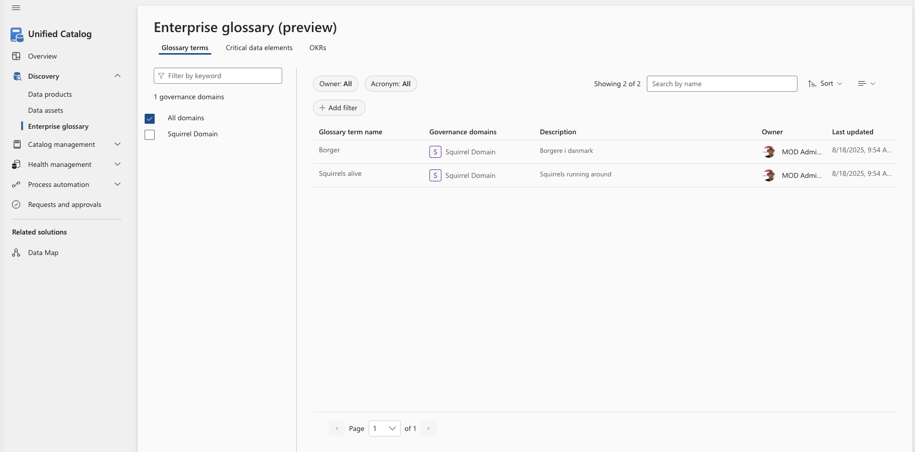
Search – Enterprise glossary – Glossary terms
The Enterprise glossary search provides access to searching glossary terms, critical data elements as well as objectives and key results (OKRs).
This screen show the glossary terms search.
You can add filters or “just” search by the name you are looking for.

Slide 11
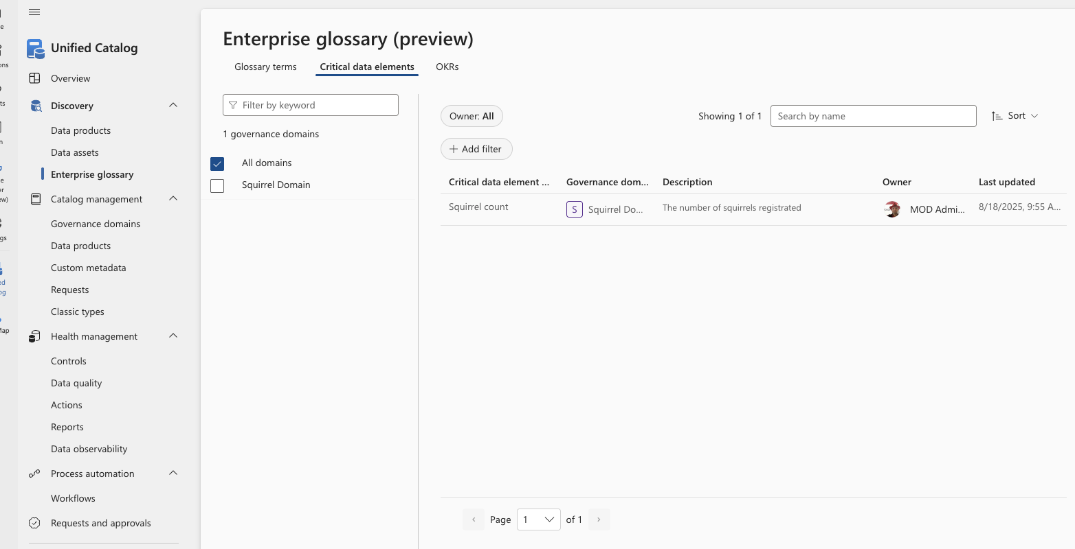
Search – Enterprise glossary – Critical data elements
The Enterprise glossary search provides access to searching glossary terms, critical data elements as well as objectives and key results (OKRs).
This screen show the Critial data elements search.
You can add filters or “just” search by the name you are looking for.

Slide 12
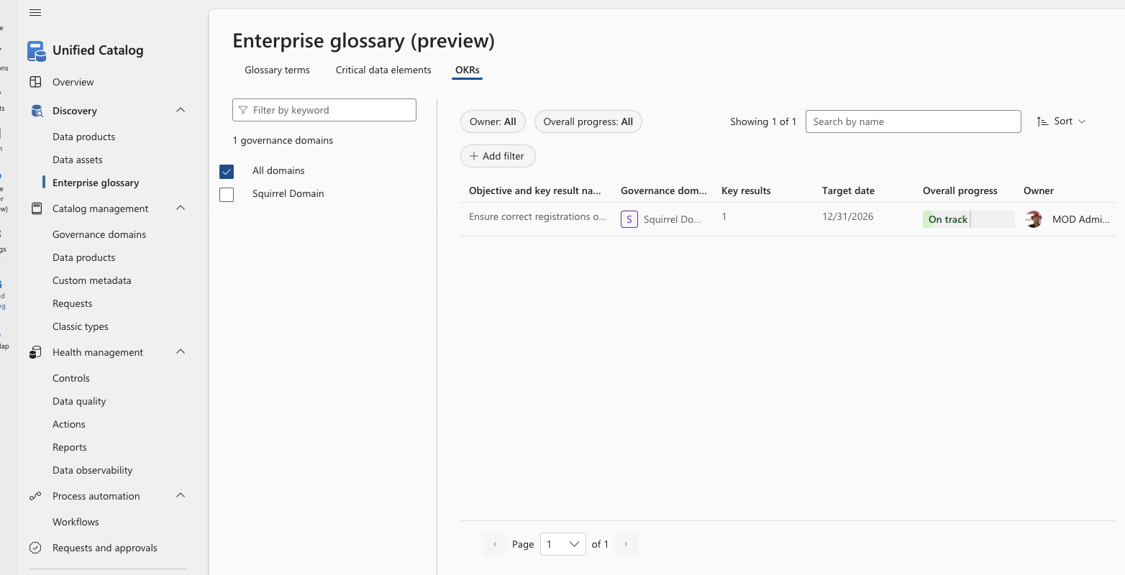
Search – Enterprise glossary – OKRs
The Enterprise glossary search provides access to searching glossary terms, critical data elements as well as objectives and key results (OKRs).
This screen show the objectives and key results (OKRs) search.
You can add filters or “just” search by the name you are looking for.

Slide 13
Catalog management
Governance domains

Slide 14
Governance Domains - overview
Governance domains provides a logical and organizational structure for managing data governance at scale.
They act as boundaries that align data assets, policies, roles, and ownership to business areas, rather than to purely technical systems.
Governance domains are designed to reflect business concepts such as departments, functions, programs, or data subject areas (for example: Finance, HR, Customer Data, Public Sector Case Management).
Governance Domains can be a created as a hierachy
Governance domains allow organizations to assign domain‑specific roles (such as data owners and data stewards) within each domain. This supports:
Distributed ownership without losing central oversight
Clear accountability for data quality, classification, and usage decisions
Scalable governance across large or federated organizations
Governance domains define where governance actions apply, including:
Data assets associated with a domain
Business metadata and definitions
Data quality rules and ownership context
This helps avoid “one‑size‑fits‑all” governance and instead supports domain‑appropriate governance controls while still using a common platform.

Slide 15
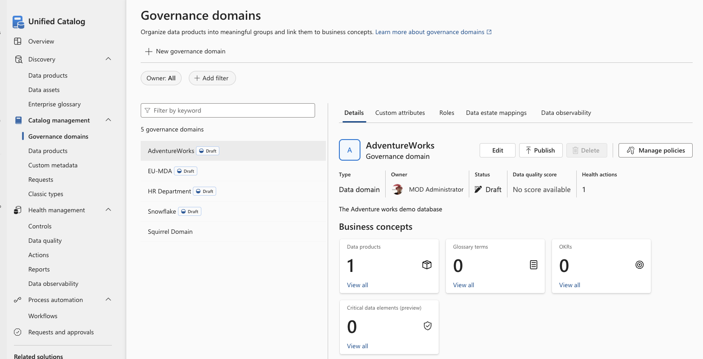
Governance Domains - creation
Governance domains can be created by clicking New Governance Domain
-or-
Be maintained by click Edit

Slide 16
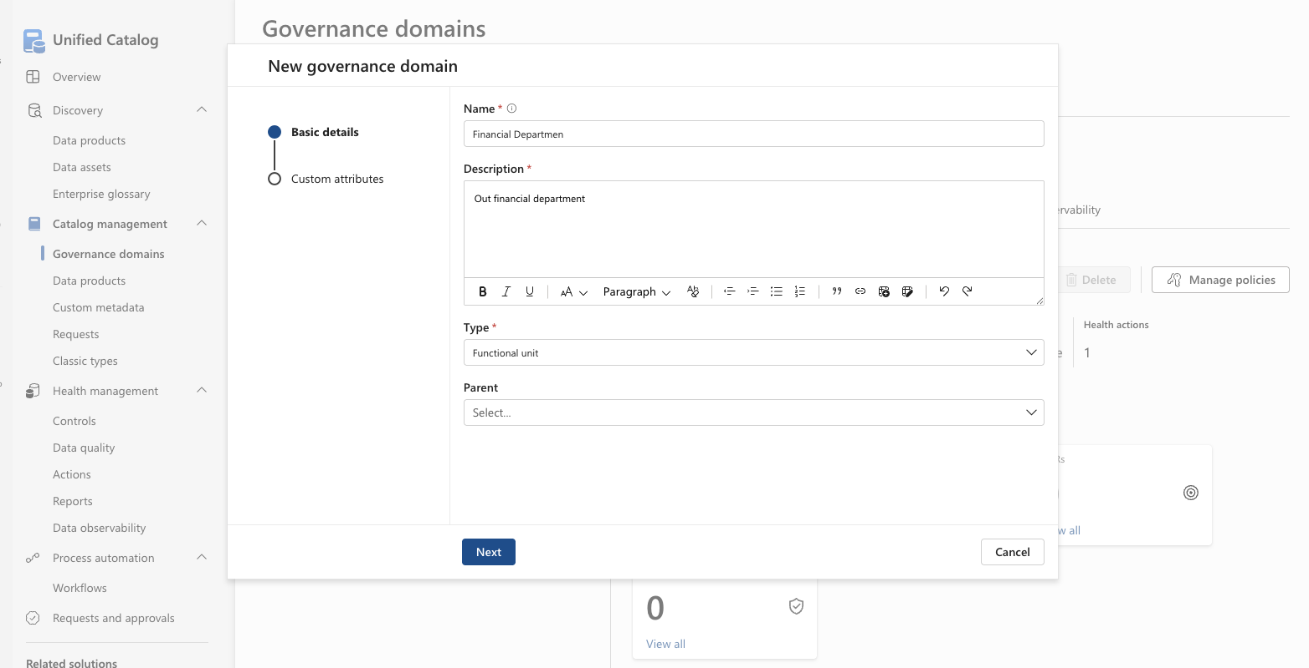
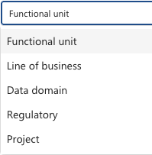
Governance Domains – creation screen - 1 of 2
A Governance domain has a required name and description.
Also, the type need to be specified and can be one of:
Functional Unit
Line of Business
Data Domain
Regulatory
Project
If this Governance Domain belongs under another Governance Domains, this parent can be selected.

Slide 17
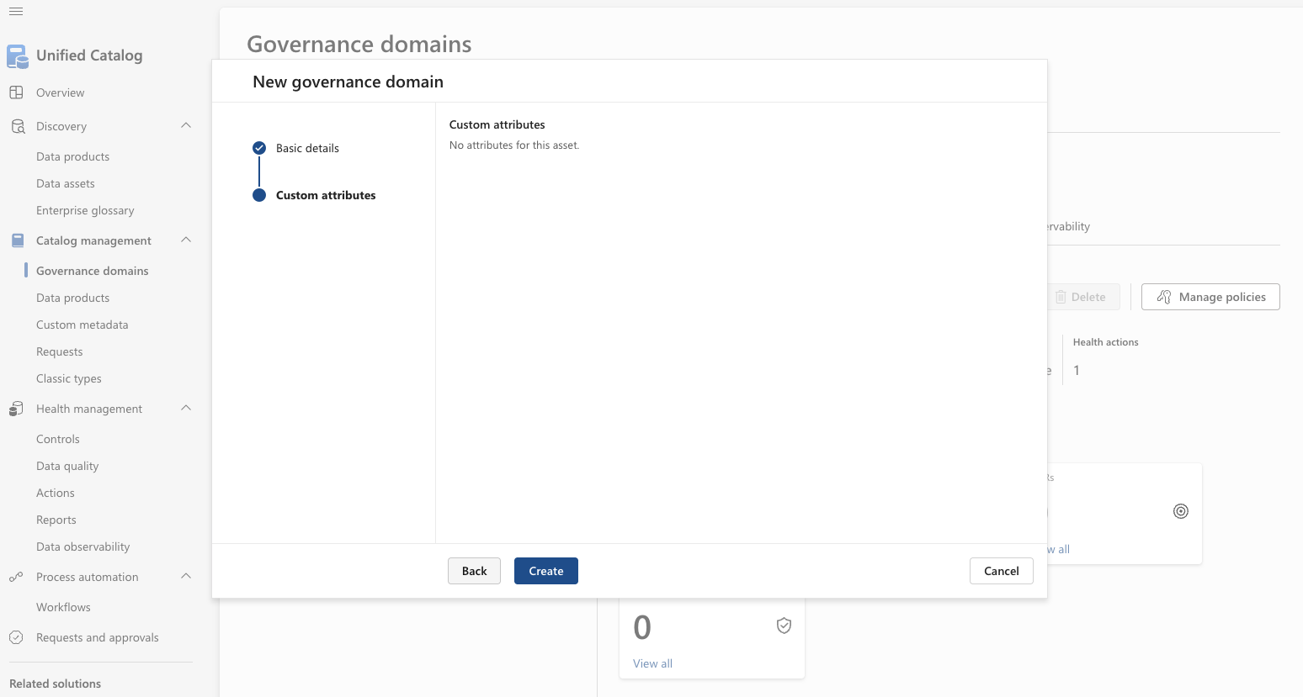
Governance Domains – creation screen - 2 of 2
If any custom attributes is available at the Governance domain level, these will be shown on the second screen.
And appropriate values can be assigned.
Click Create to create the Governance Domain.

Slide 18
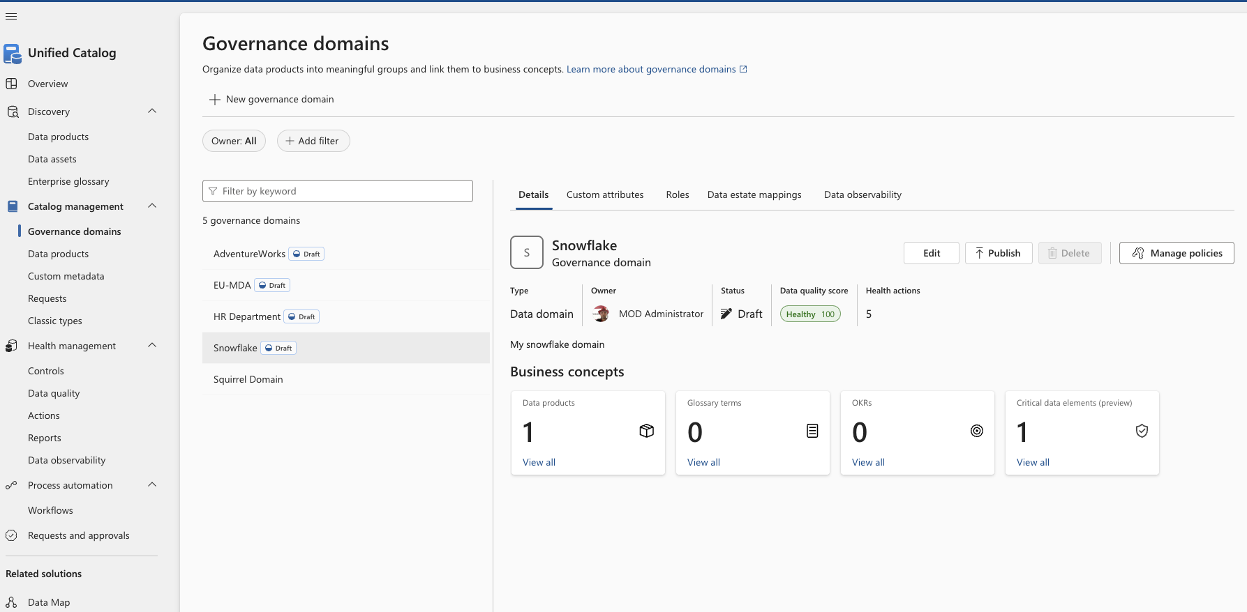
Governance Domains – Overview screen - details

Slide 19
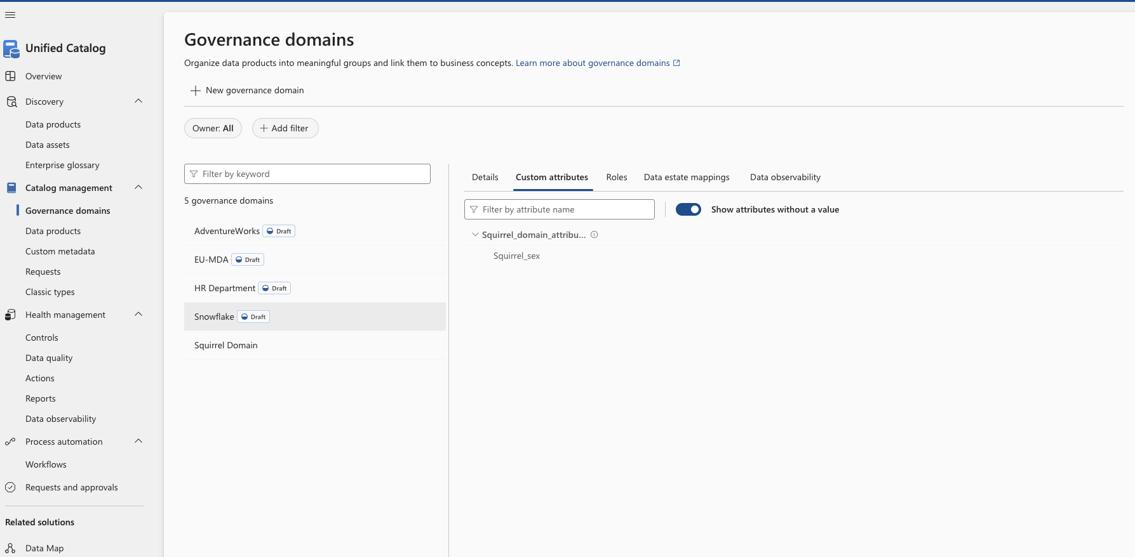
Governance Domains – Overview screen – custom attributes

Slide 20
Governance Domains – Overview screen - roles

Slide 21
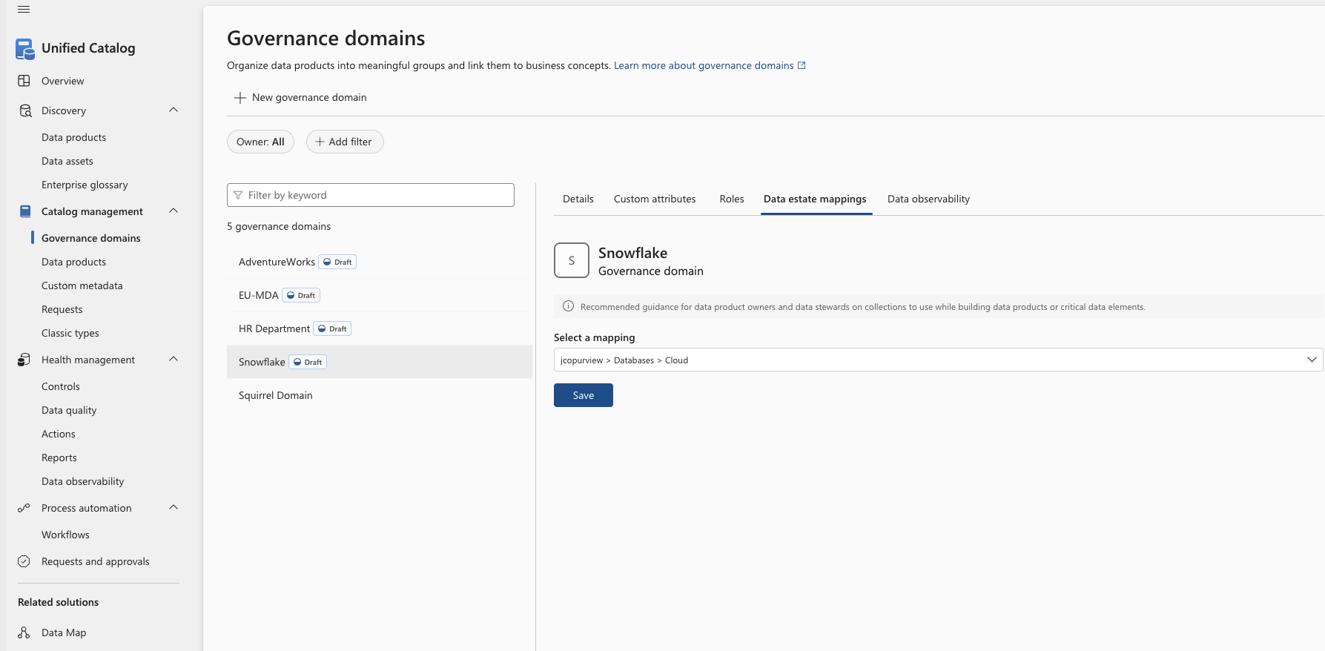
Governance Domains – Overview screen – Data Estate mappings

Slide 22
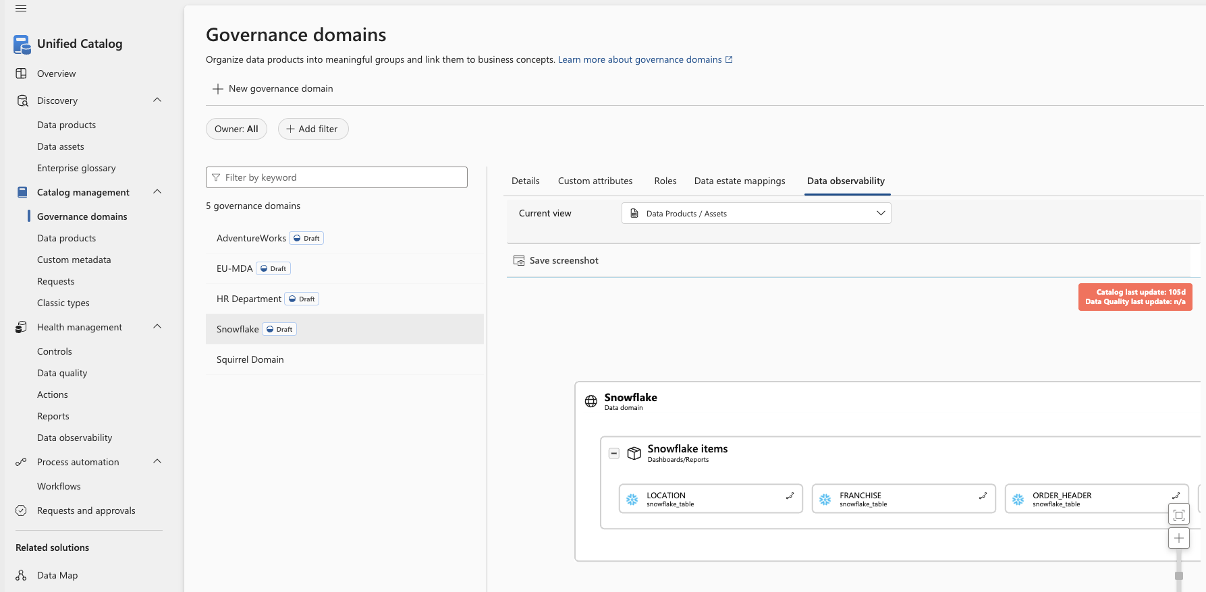
Governance Domains – Overview screen – Data obervability

Slide 23
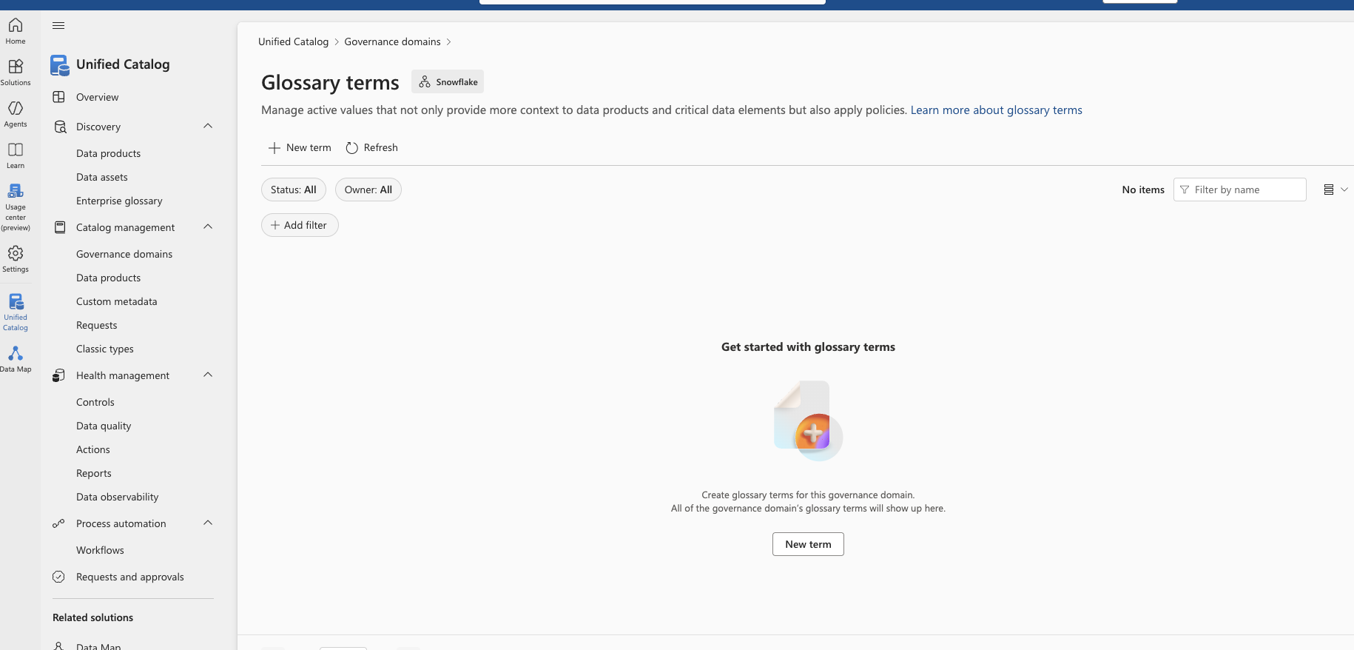
Governance Domains – Glossary terms

Slide 24
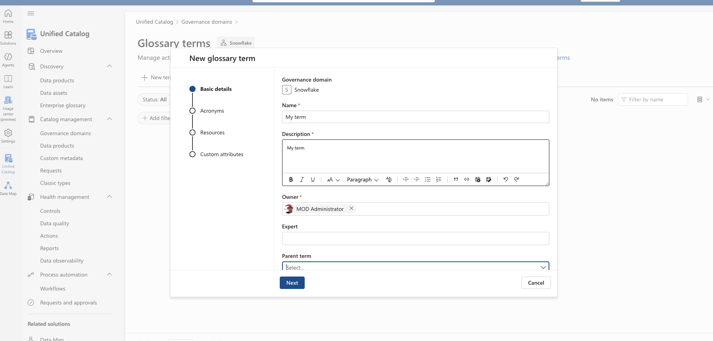
Governance Domains – Glossary terms

Slide 25
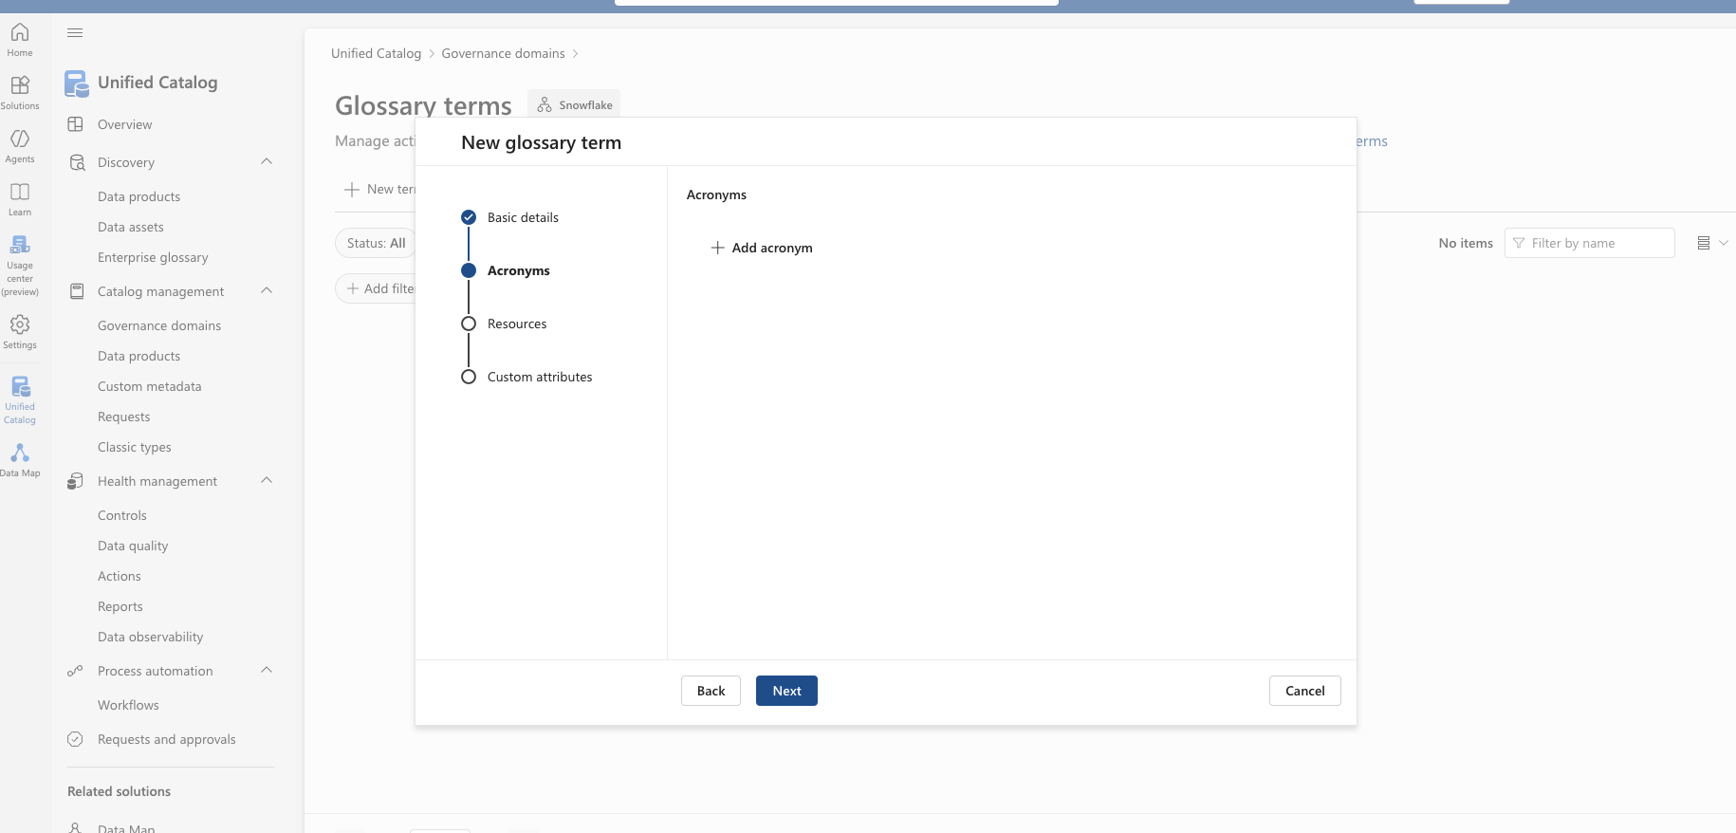
Governance Domains – Glossary terms

Slide 26

Governance Domains – Glossary terms

Slide 27
Governance Domains – Glossary terms

Slide 28
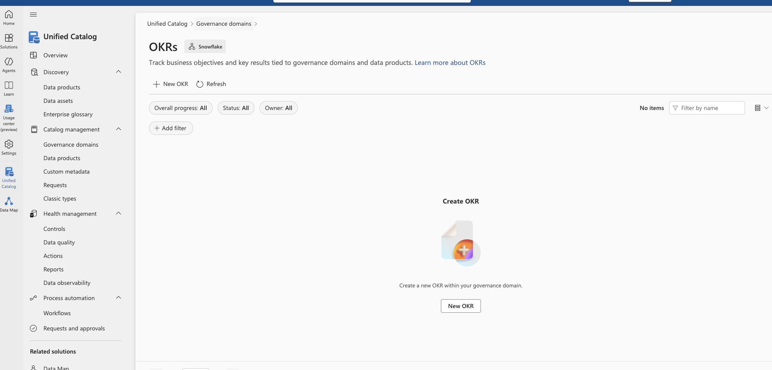
Governance Domains – Objectives and key results

Slide 29
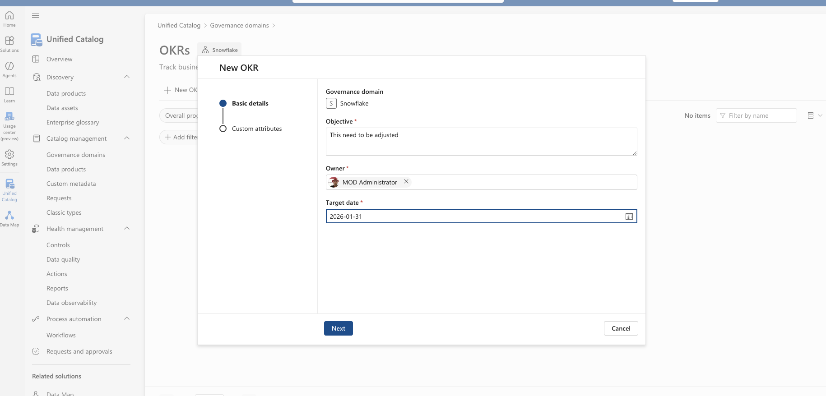
Governance Domains – Objectives and key results

Slide 30
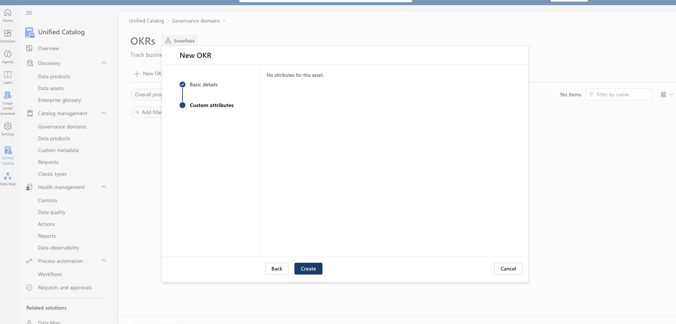
Governance Domains – Objectives and key results

Slide 31
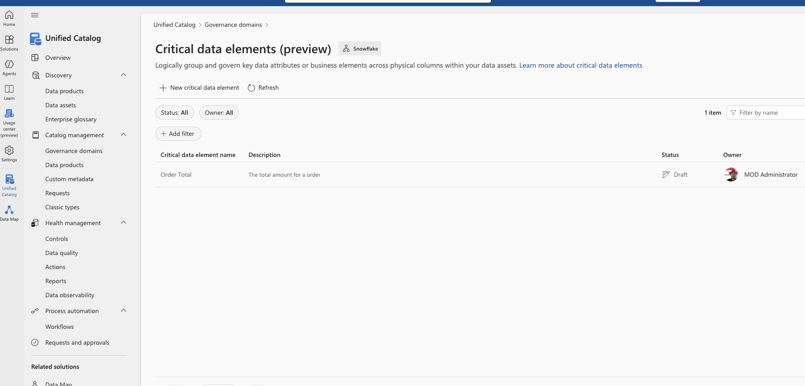
Governance Domains – Critical Data Elements

Slide 32
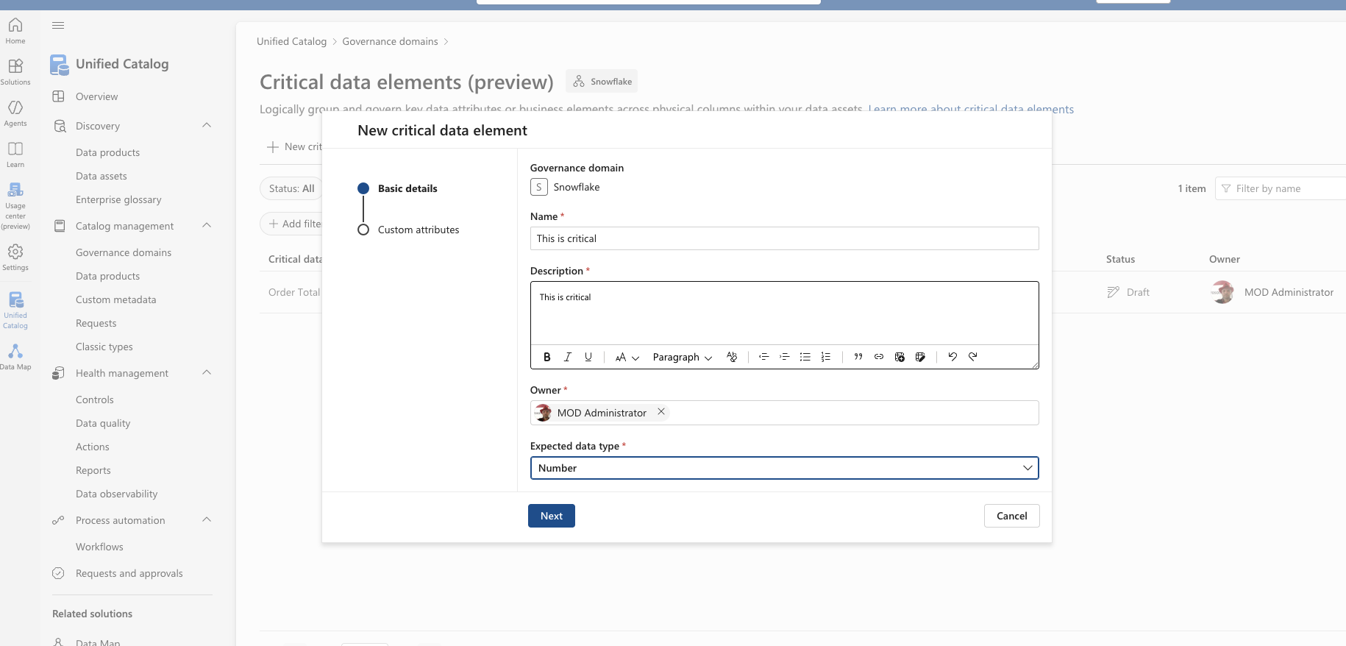
Governance Domains – Critical Data Elements

Slide 33
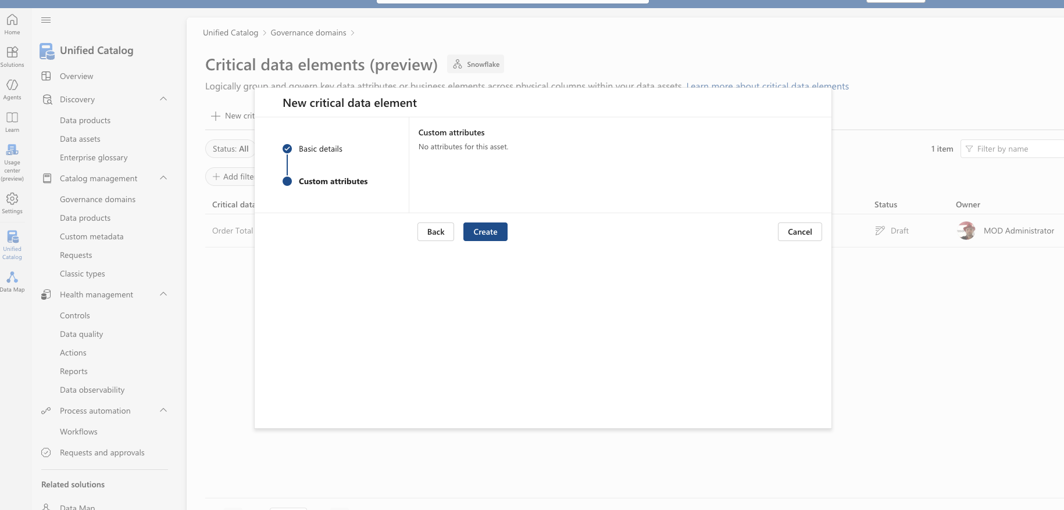
Governance Domains – Critical Data Elements

Slide 34
Catalog management
Data Products

Slide 35
A Data Product in Microsoft Purview represents a business-ready, governed data asset that is intentionally designed for consumption—not just a raw dataset.
Microsoft positions data products as the unit of value delivery in modern data governance: they bundle data + metadata + governance + ownership + quality expectations into something that can be discovered, trusted, and reused.

Slide 36
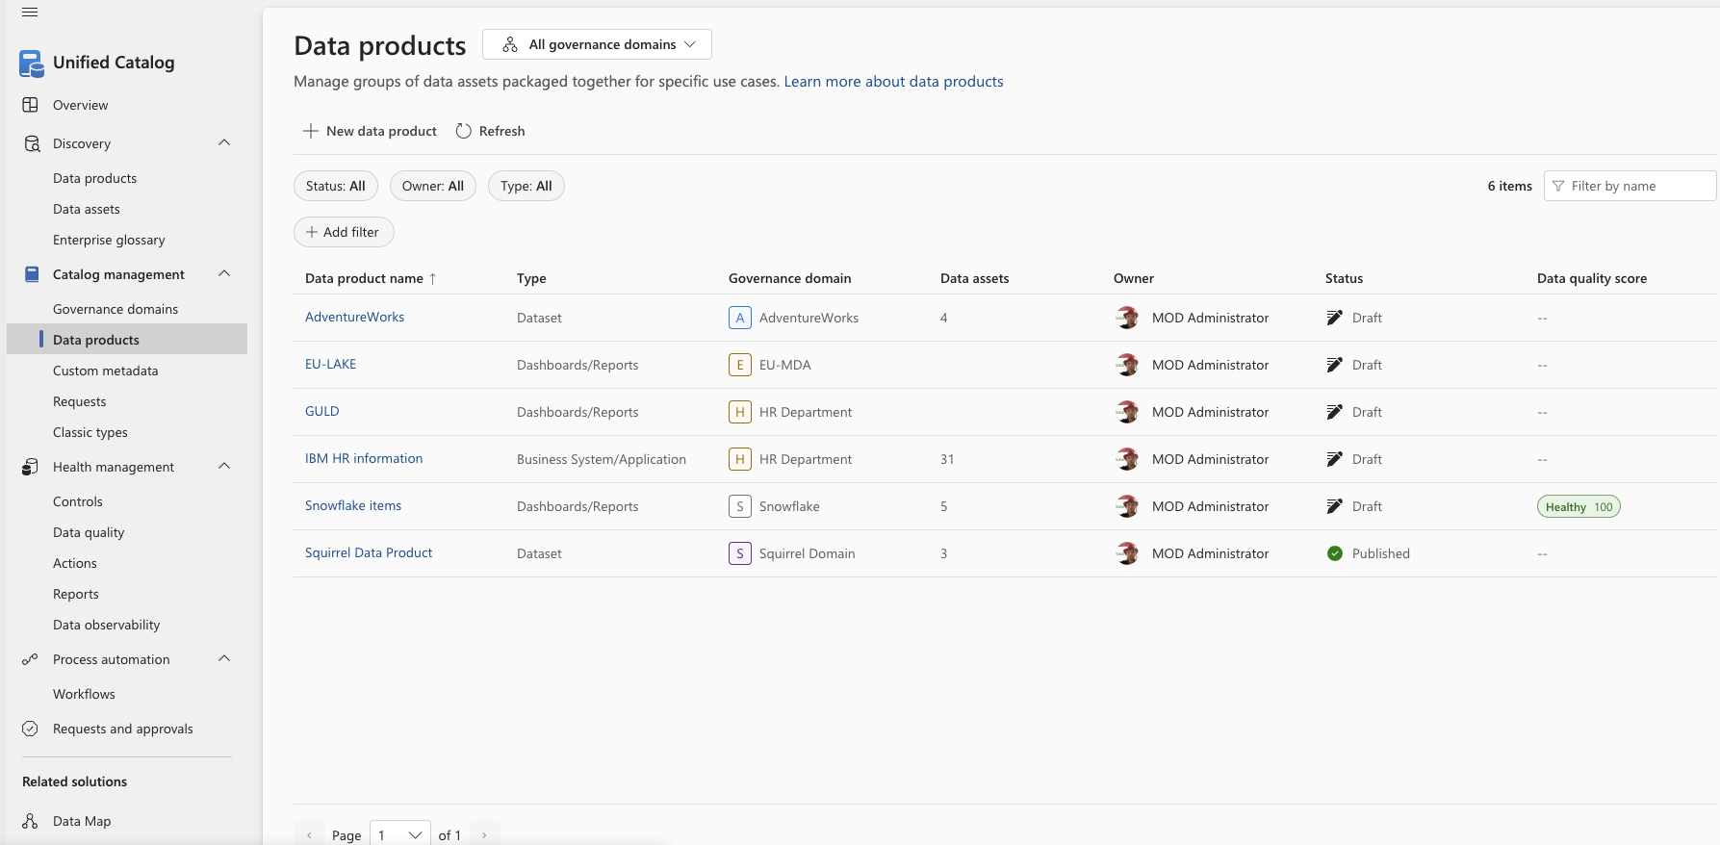
Data Product– Critical Data Elements
Data Products can be created by clicking New data product
-or-
Be maintained by clicking a Data Product

Slide 37
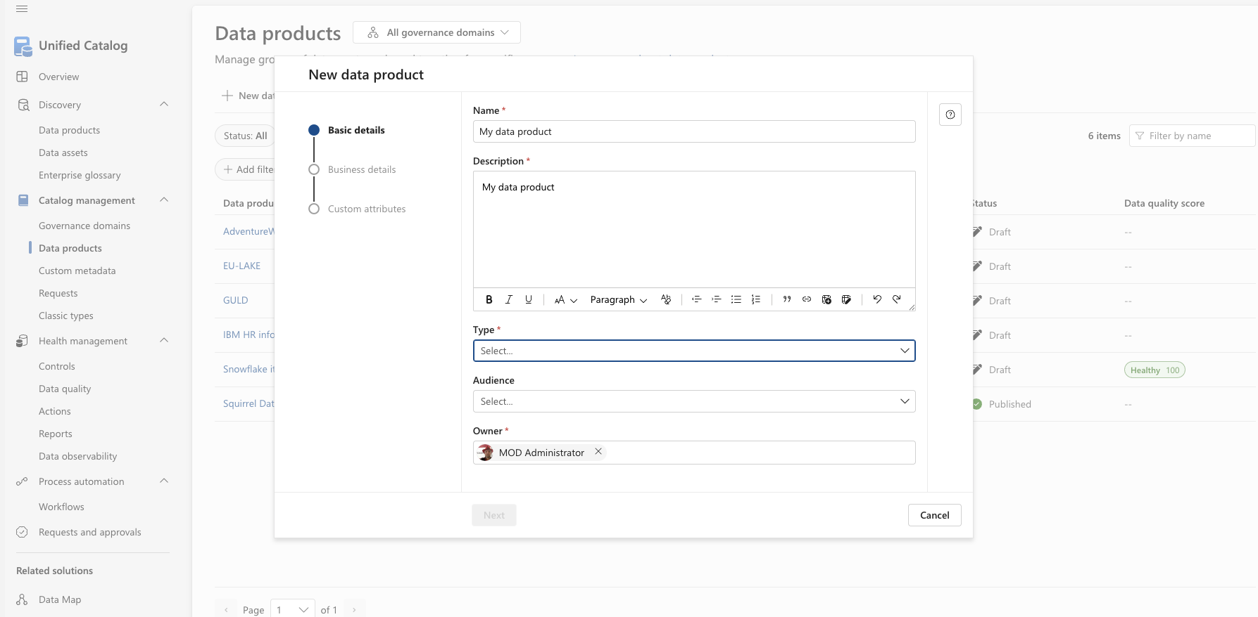

Slide 39
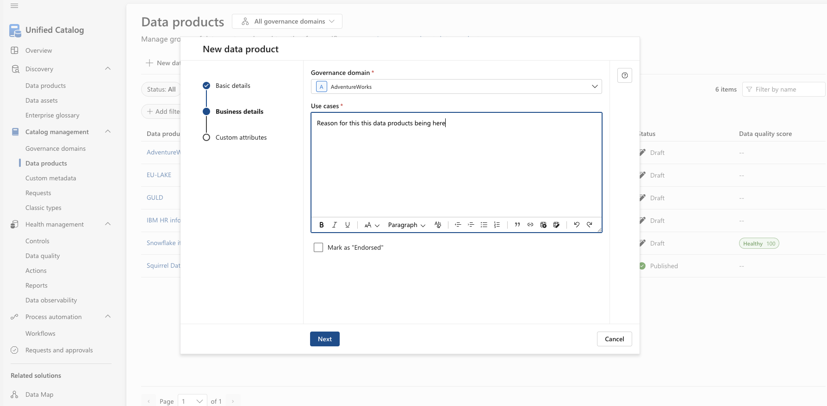

Slide 40
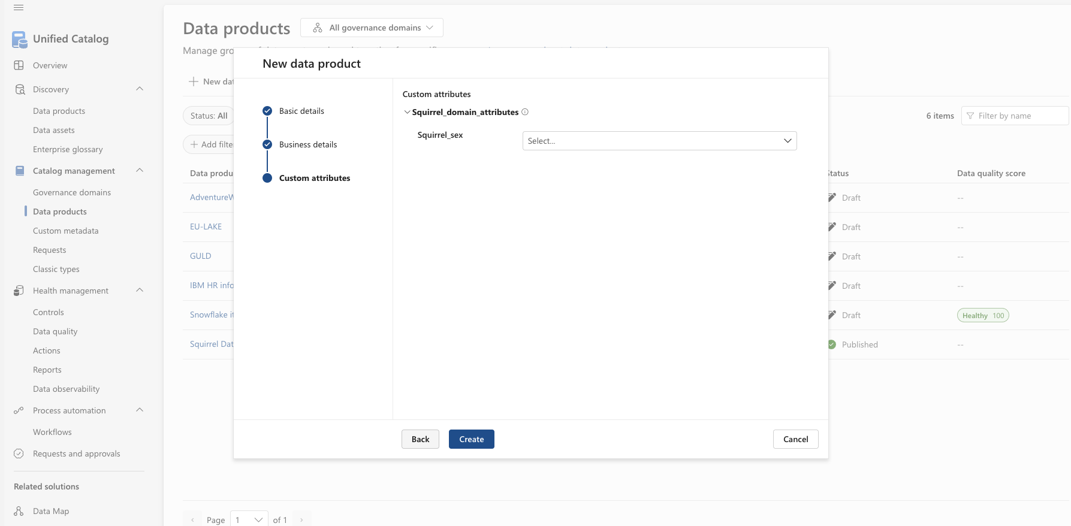

Slide 41
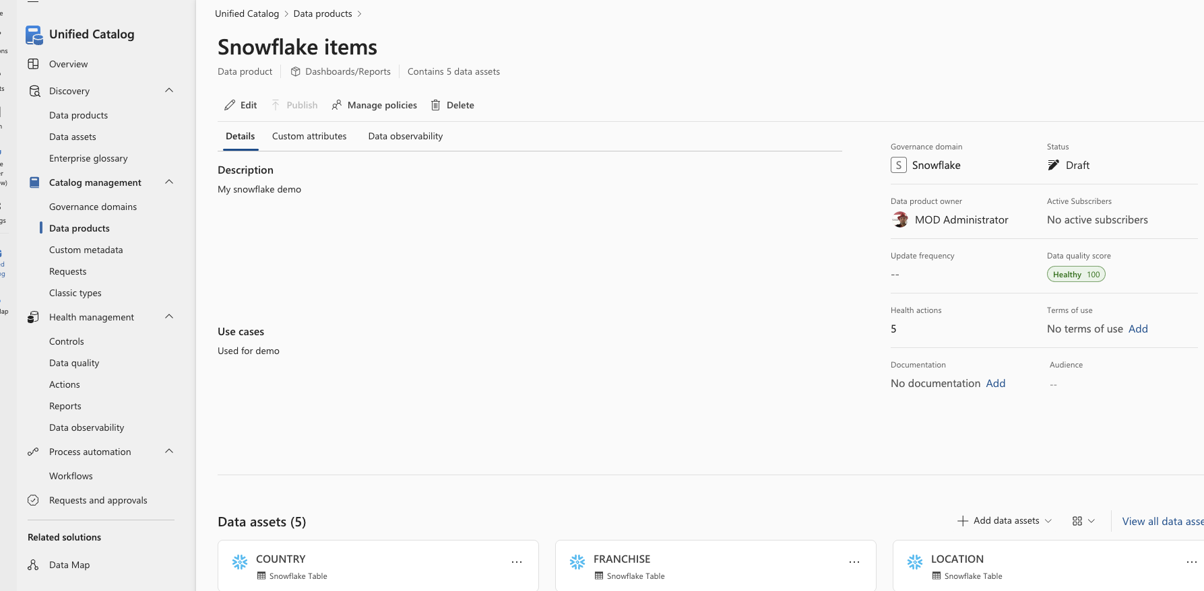

Slide 42
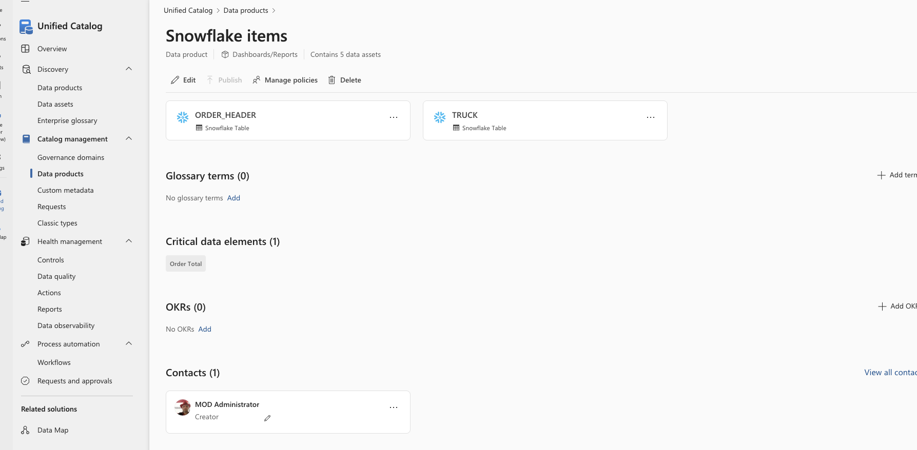

Slide 43
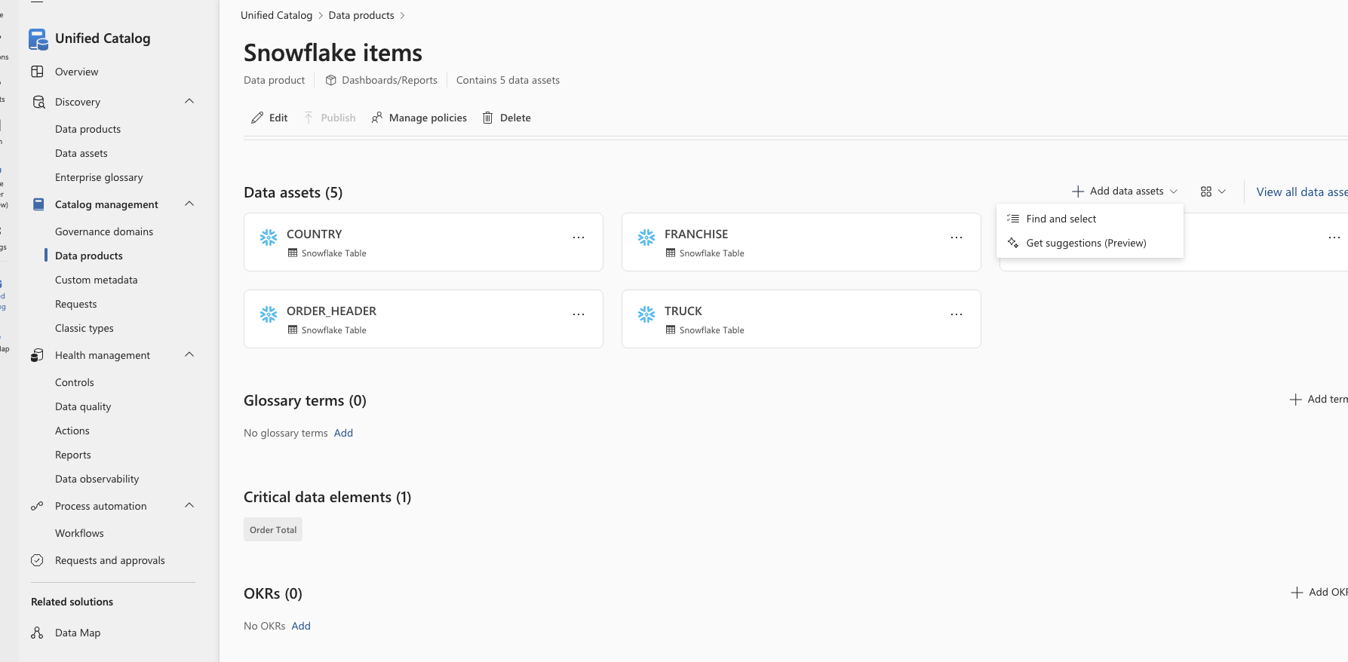

Slide 44
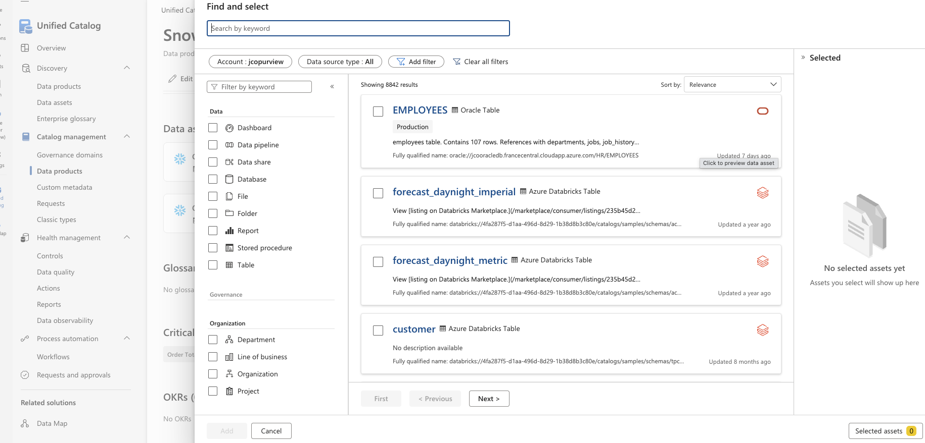

Slide 45
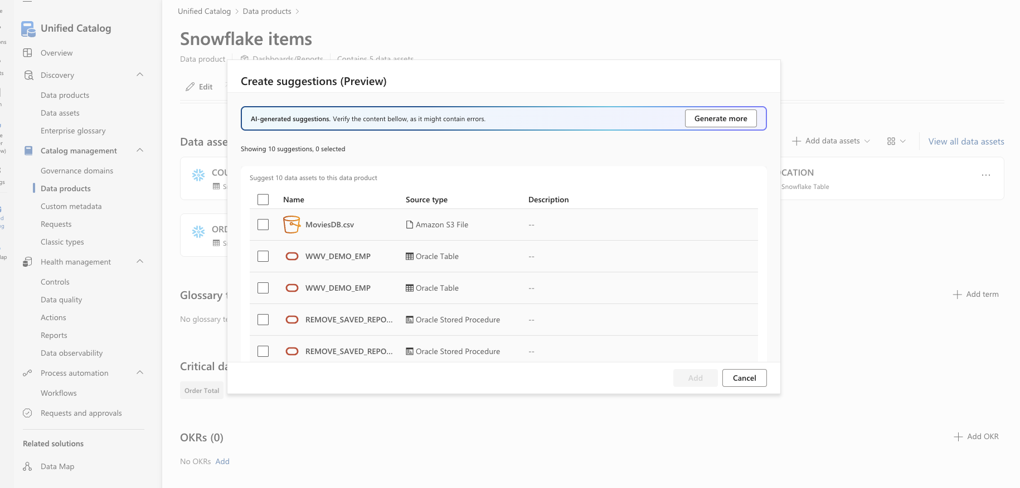

Slide 46
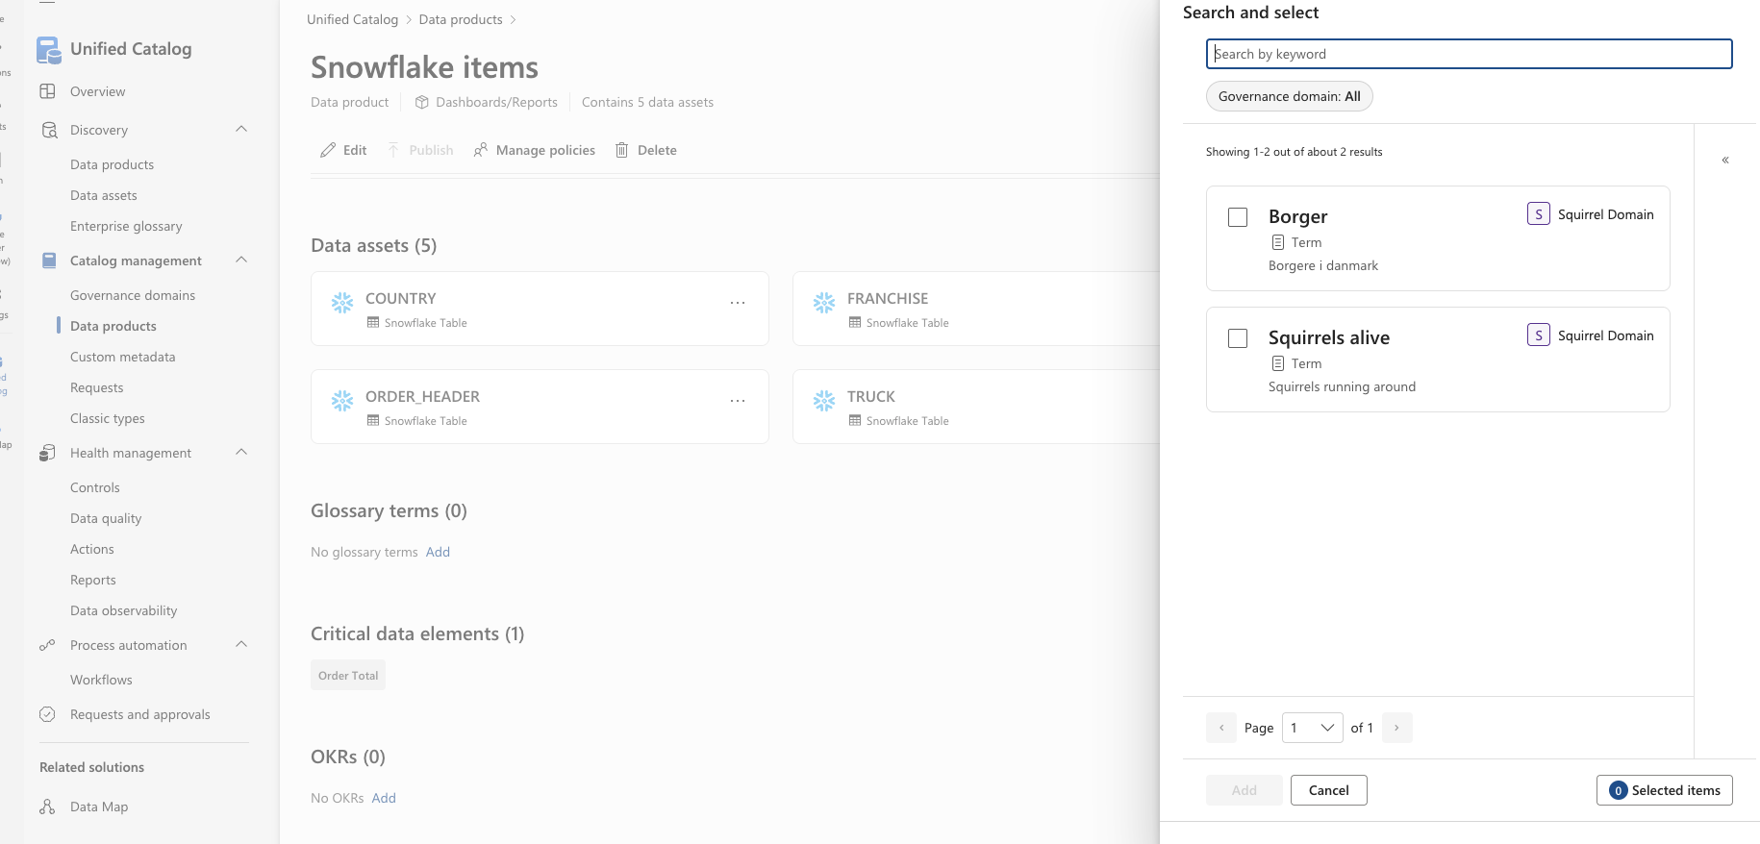

Slide 48
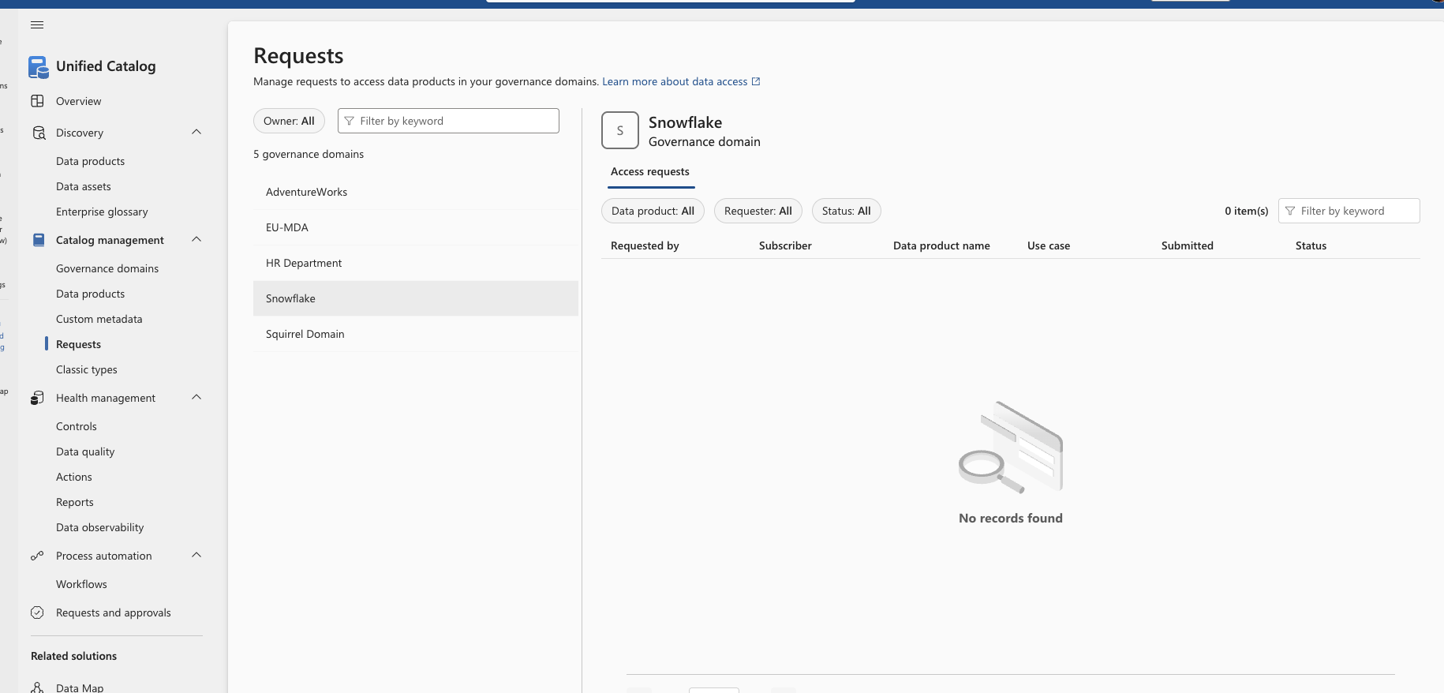

Slide 49
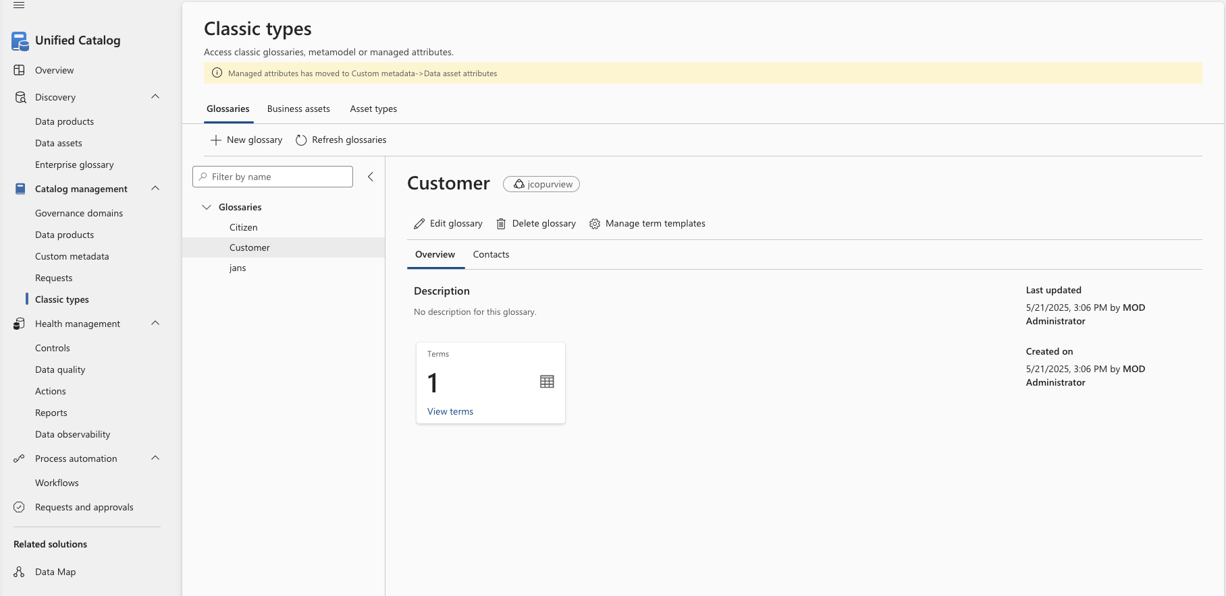

Slide 50
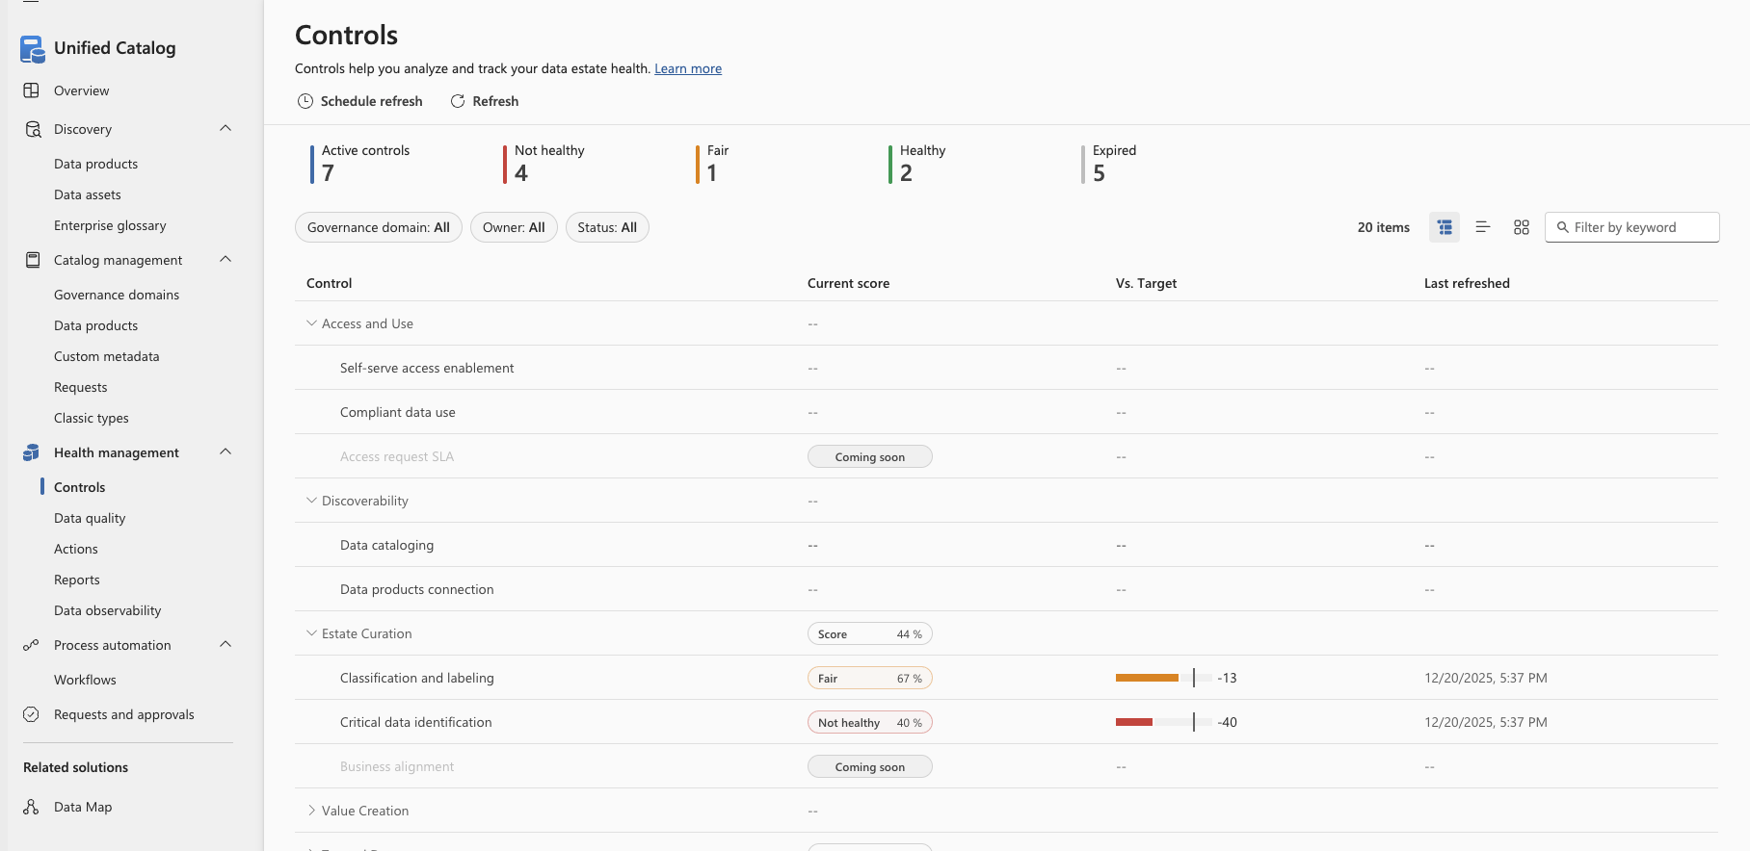

Slide 51
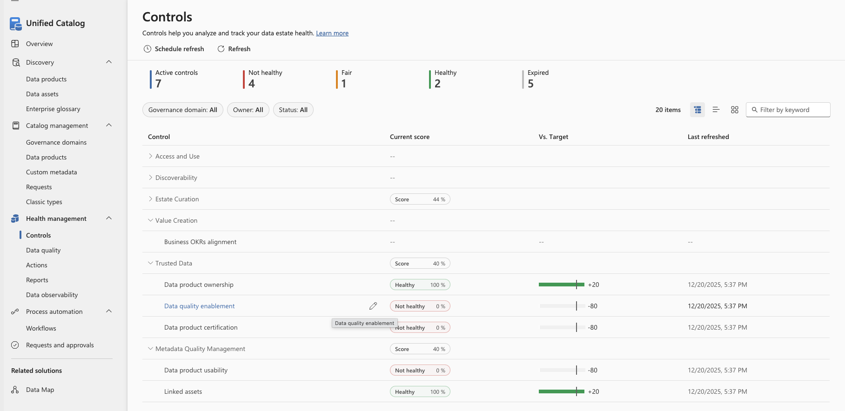

Slide 52
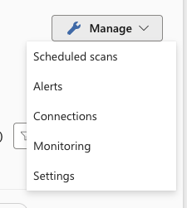
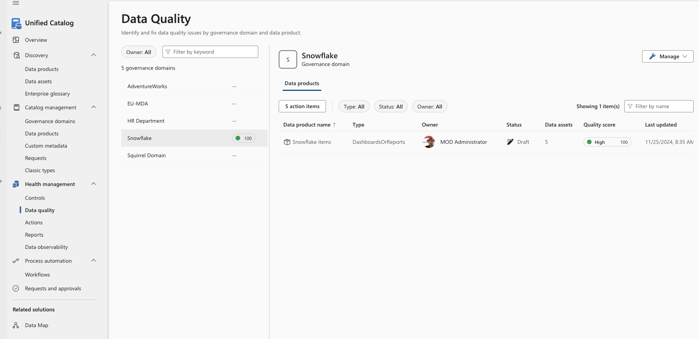

Slide 53
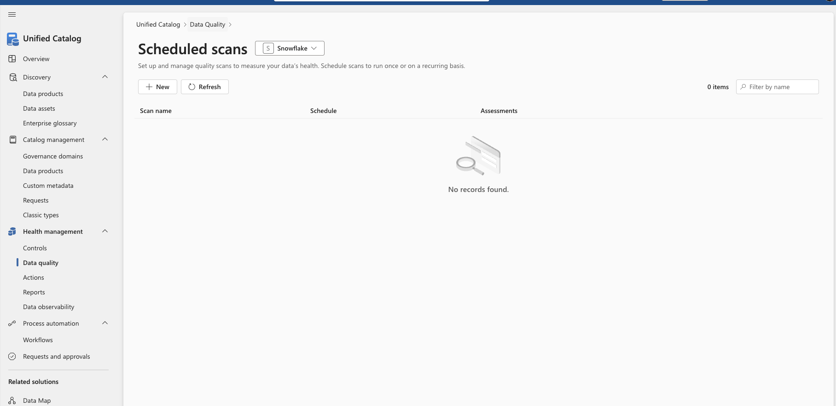

Slide 54
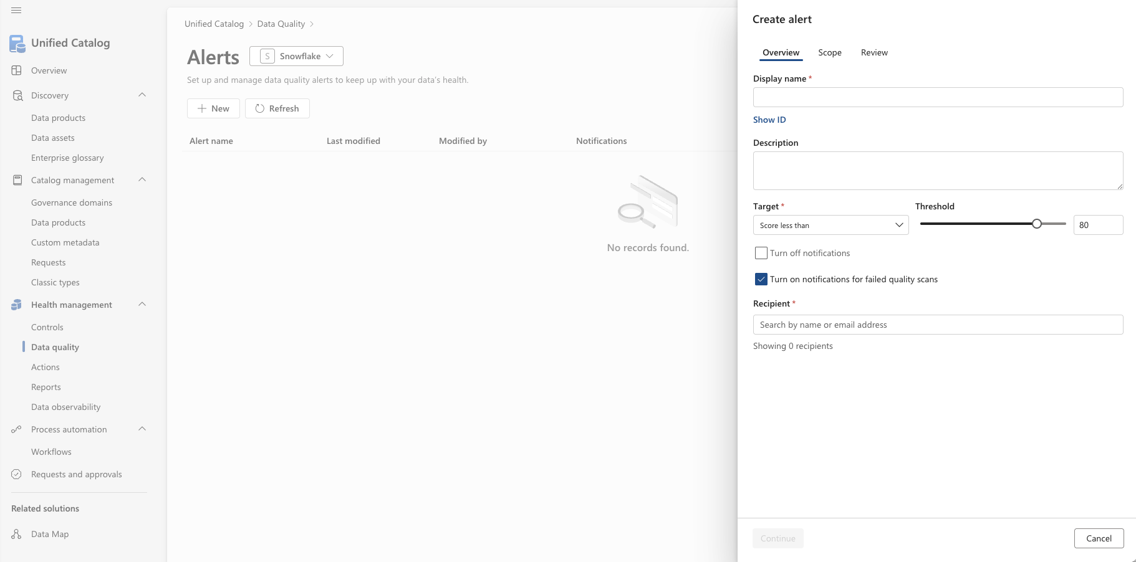

Slide 55
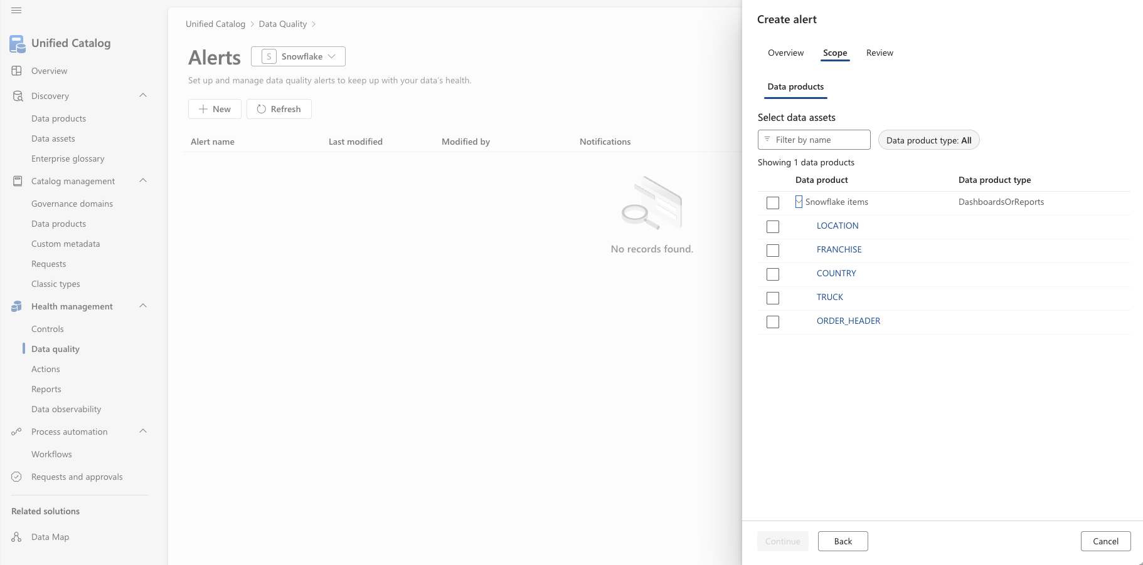

Slide 56
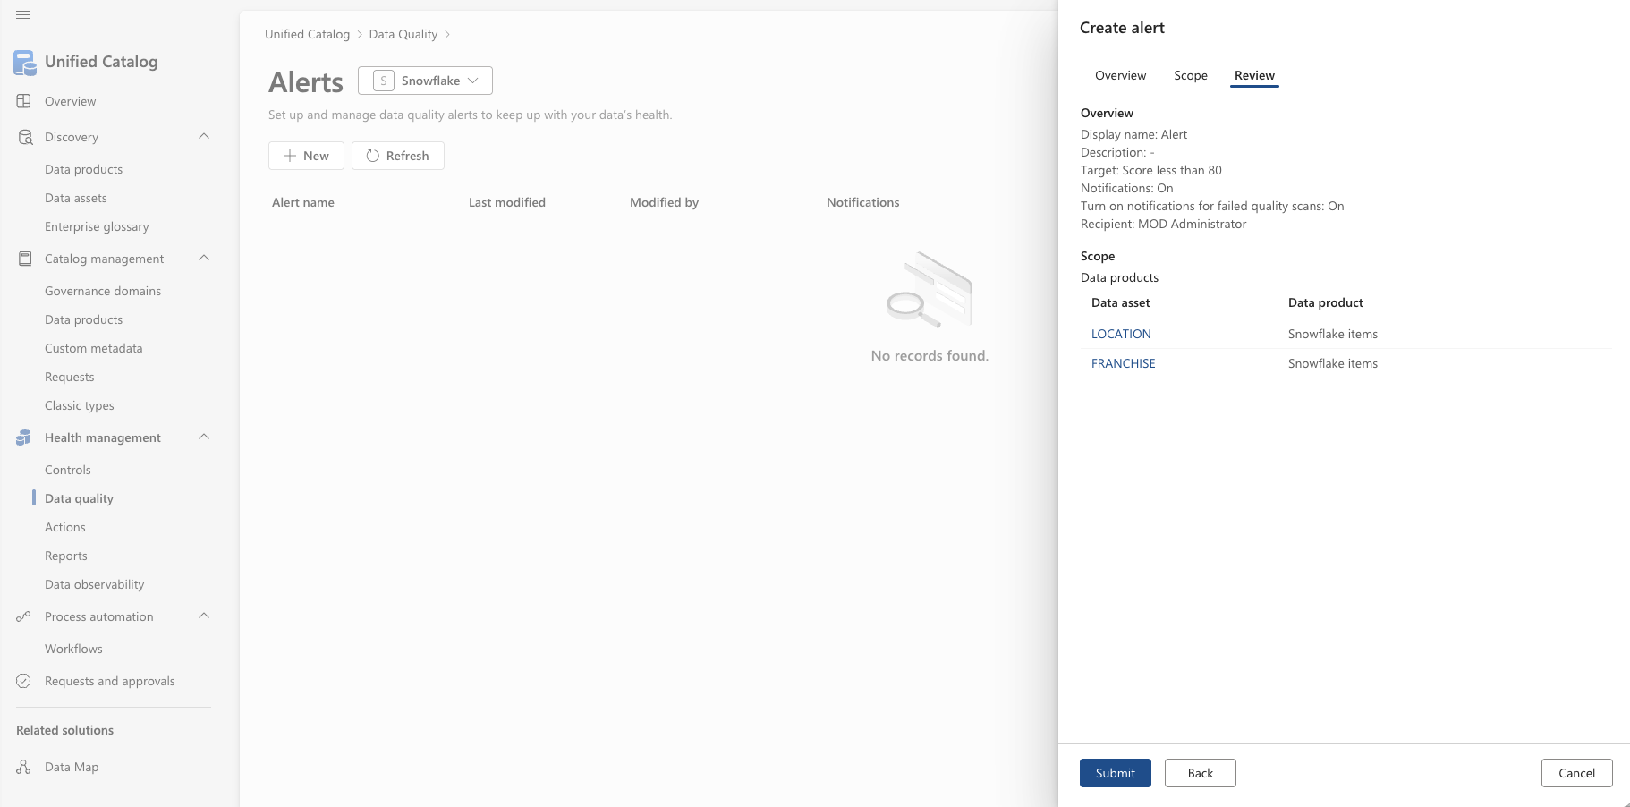

Slide 57
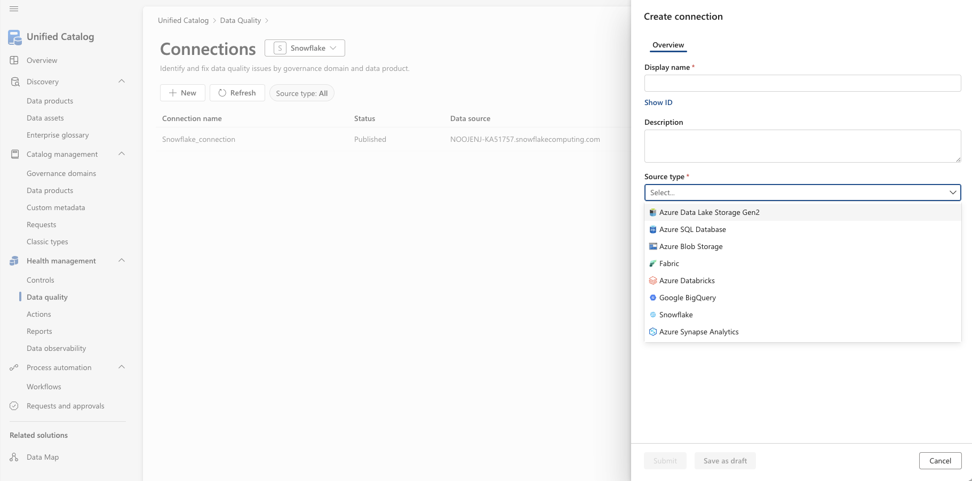

Slide 58
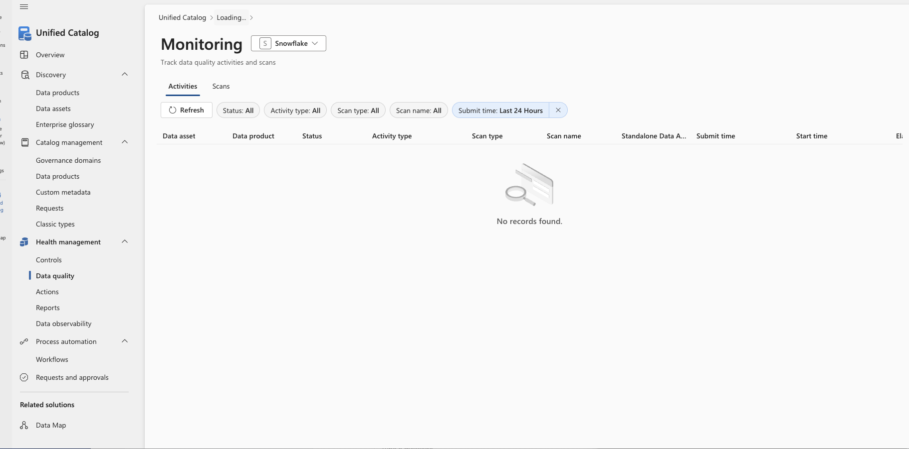

Slide 60
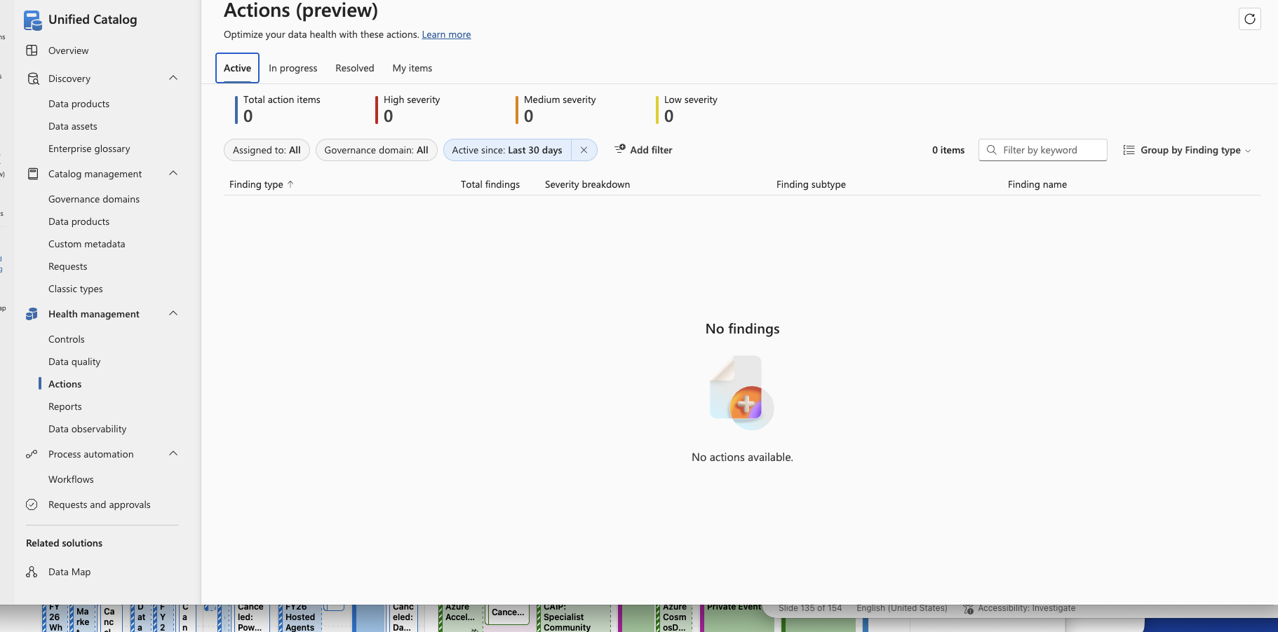

Slide 61
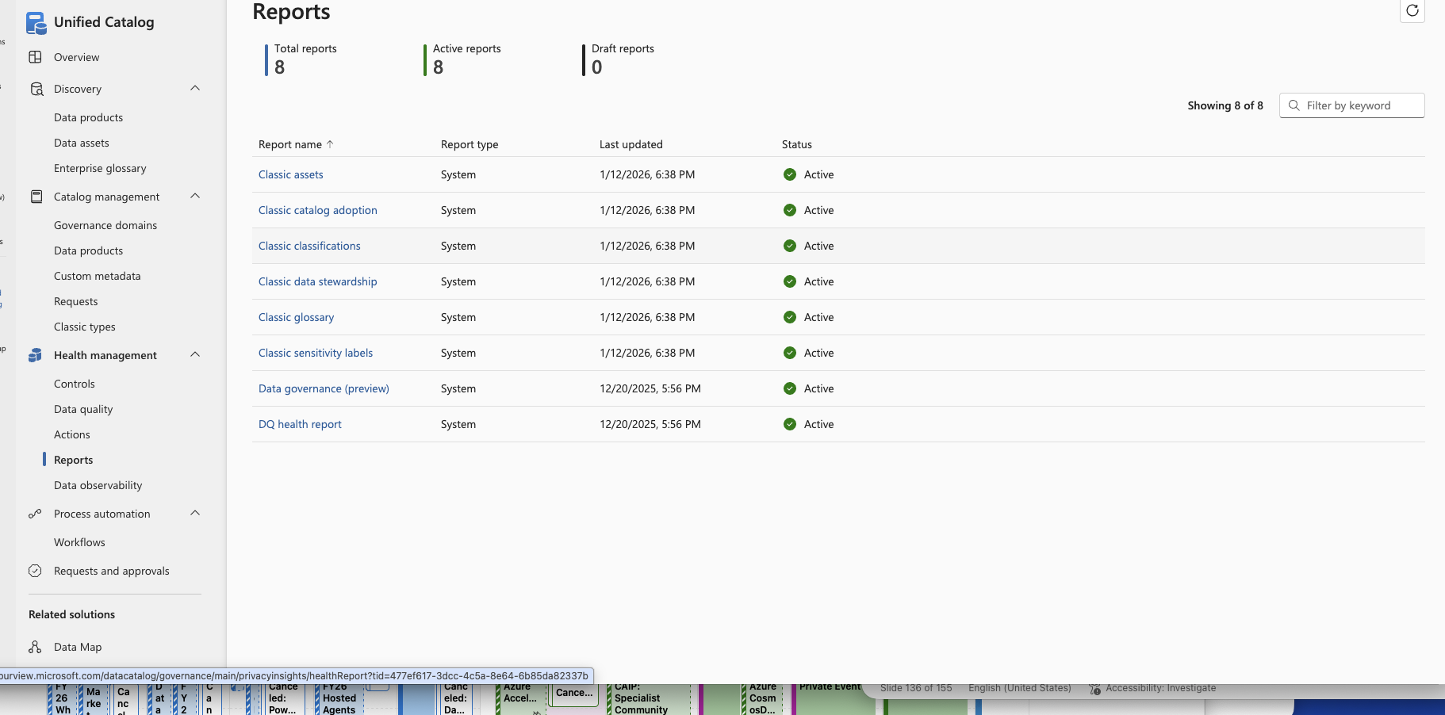

Slide 62
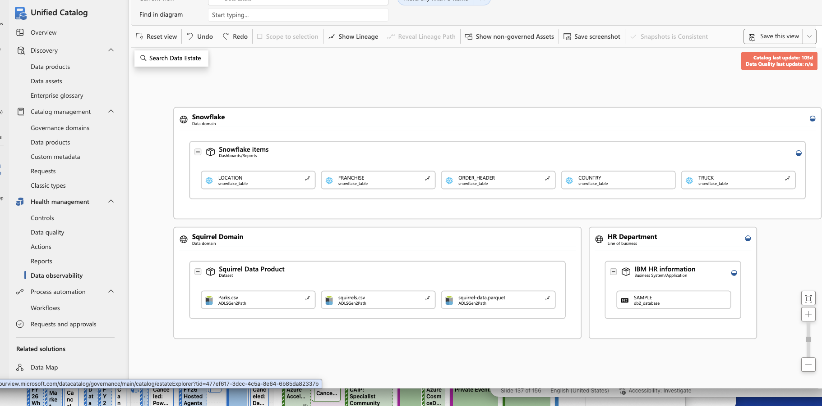

Slide 63
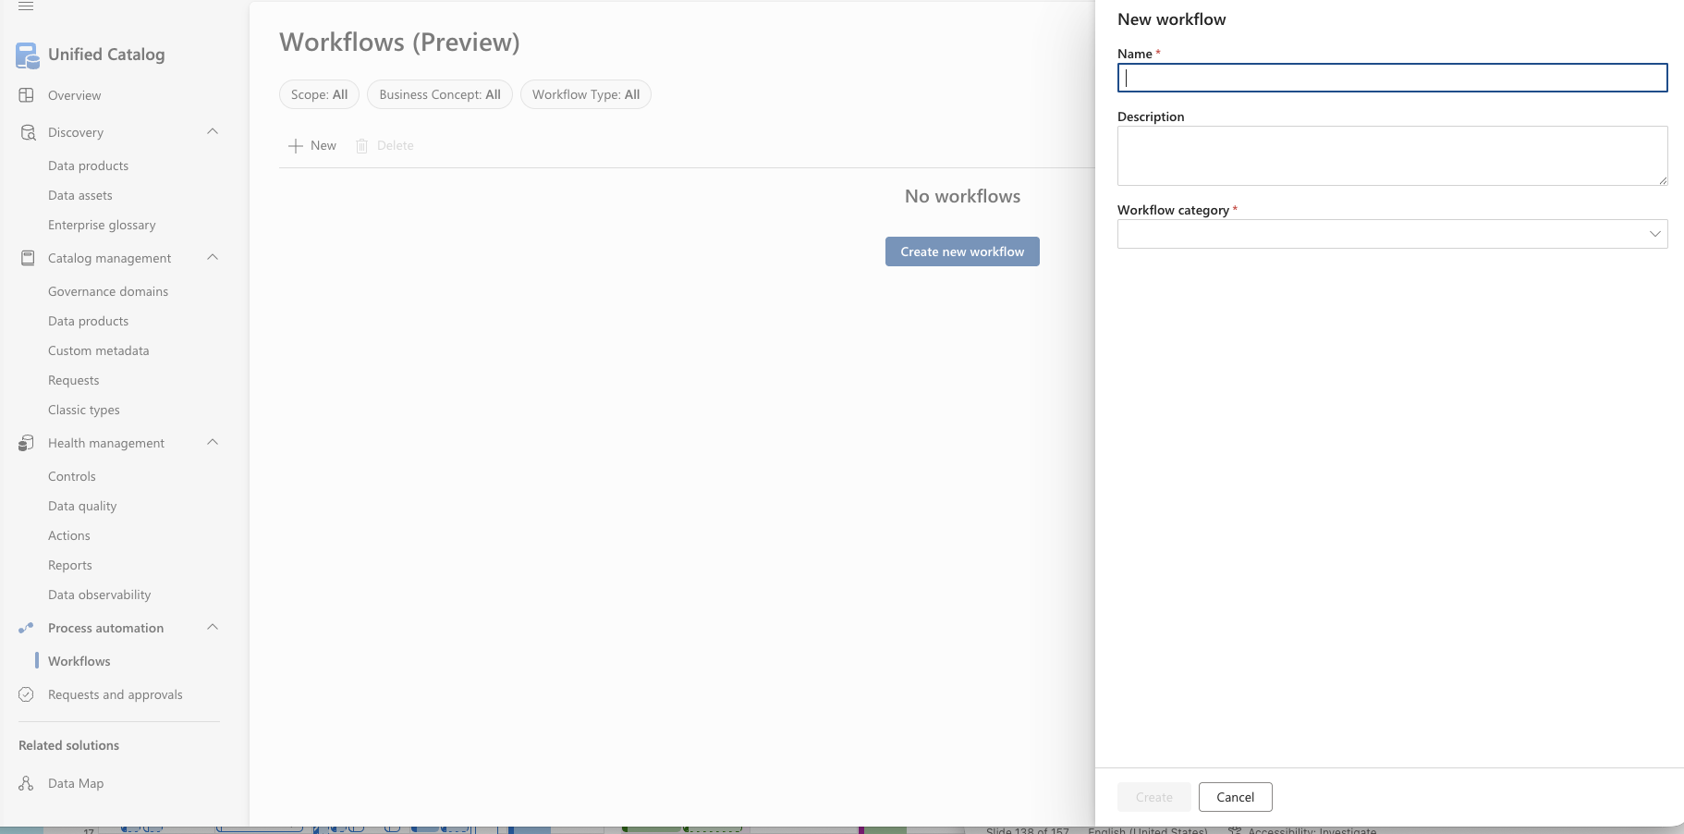

Slide 64


Slide 65
Data Quality

Slide 66


Slide 67


Slide 68


Slide 69


Slide 71


Slide 72


Slide 73


Slide 74


Slide 75


Slide 76


Slide 77


Slide 78


Slide 79


Slide 80


Slide 81


Slide 82
Policies

